Slide 1
Hotel Reservation Analysis
USING SQL

Slide 2
Overview
In the hotel industry, information helps make guest stays more enjoyable. I analyzed hotel booking data to understand guest preferences, booking behaviors, and factors impacting the hotel's success. Using SQL, I sifted through the data to find precise answers to key questions.

Slide 3
Dataset Details
Booking_ID: A unique identifier for each hotel reservation.
no_of_adults: The number of adults in the reservation.
no_of_children: The number of children in the reservation.
no_of_weekend_nights: The number of nights in the reservation that fall on weekends.
no_of_week_nights: The number of nights in the reservation that fall on weekdays.
type_of_meal_plan: The meal plan chosen by the guests.
room_type_reserved: The type of room reserved by the guests.
lead_time: The number of days between booking and arrival.
arrival_date: The date of arrival.
market_segment_type: The market segment to which the reservation belongs.
avg_price_per_room: The average price per room in the reservation.
booking_status: The status of the booking.

Slide 4
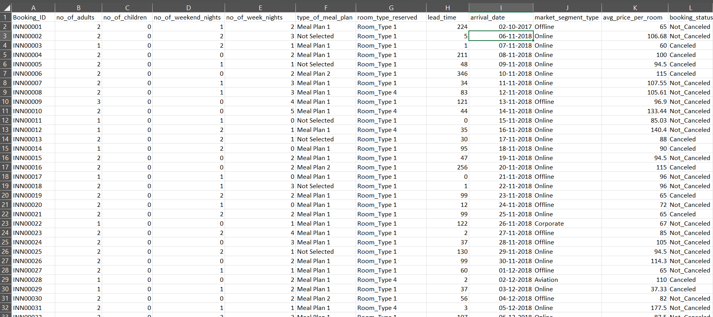
Excel

Slide 5
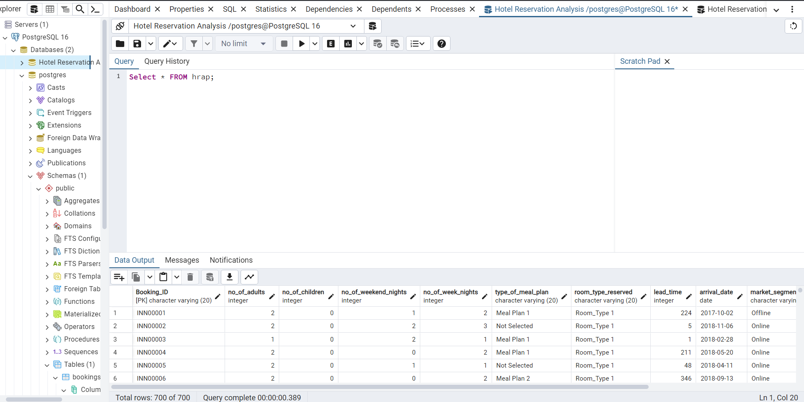
Import Data From CSV File by SQL Server
Product A
Product B
Feature 1
Feature 2
Feature 3
Feature 1
Feature 2
Feature 3

Slide 6
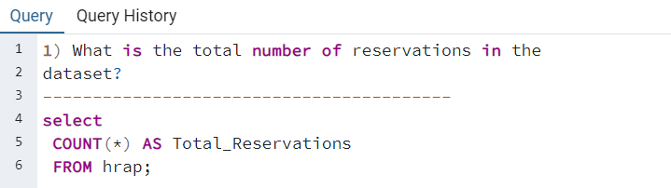
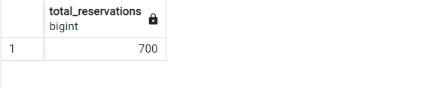
SQL Query

Slide 7
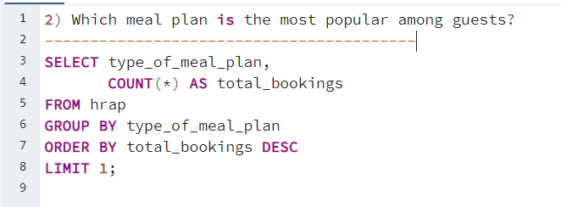
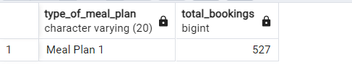

Slide 8
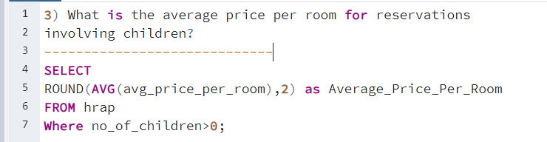
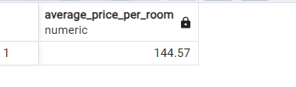

Slide 9
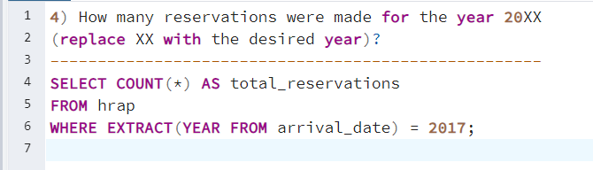
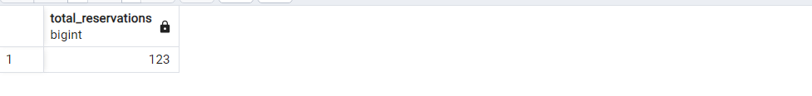

Slide 10
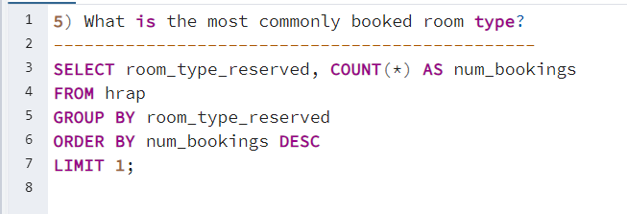
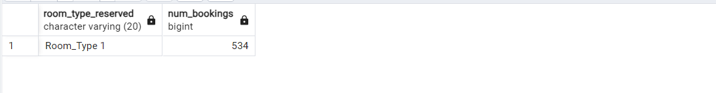

Slide 11
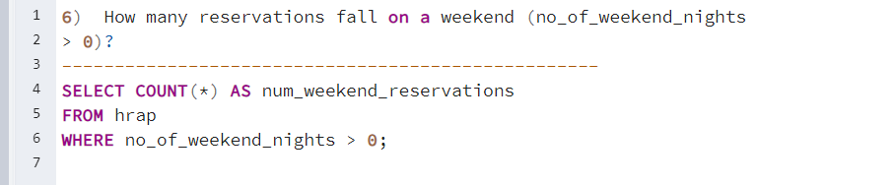
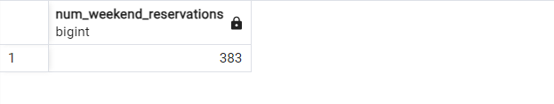

Slide 12
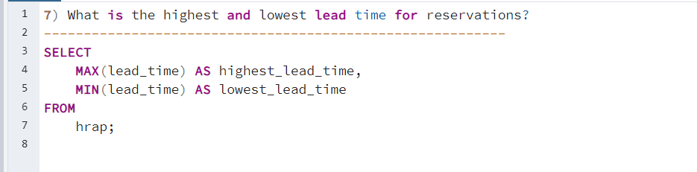
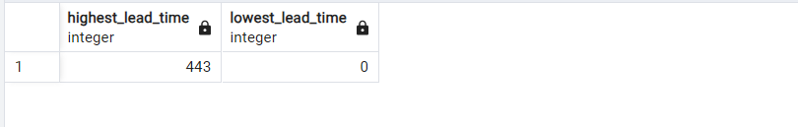

Slide 13
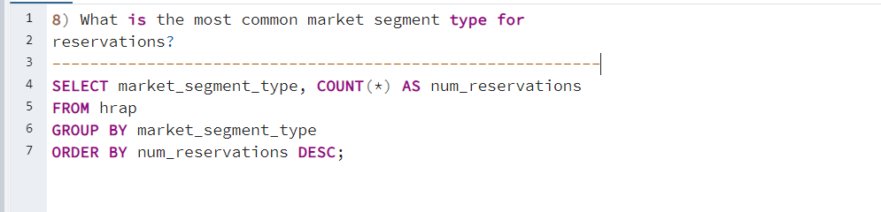
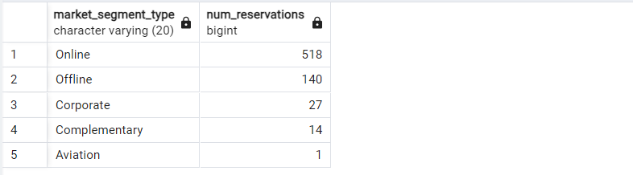

Slide 14
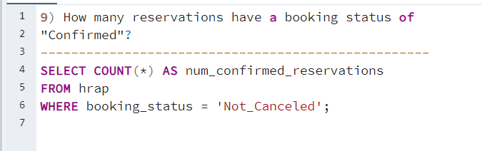
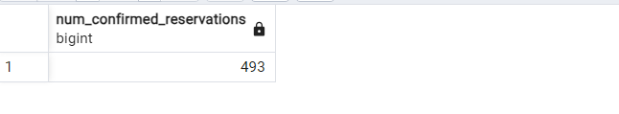

Slide 15
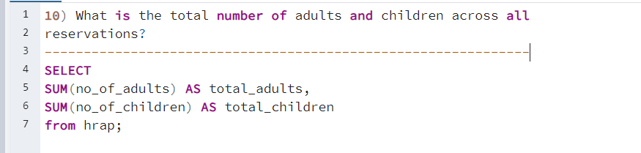
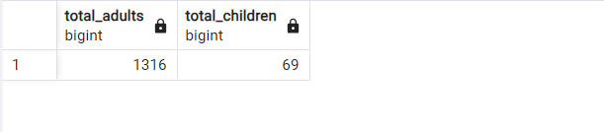

Slide 16
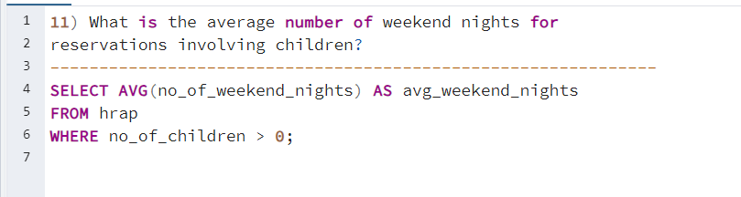
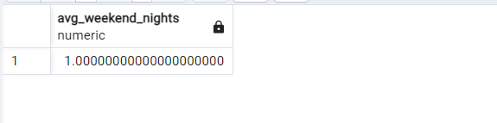

Slide 17
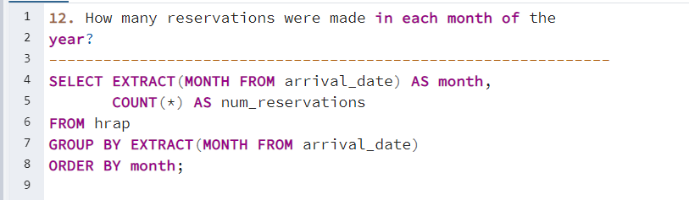
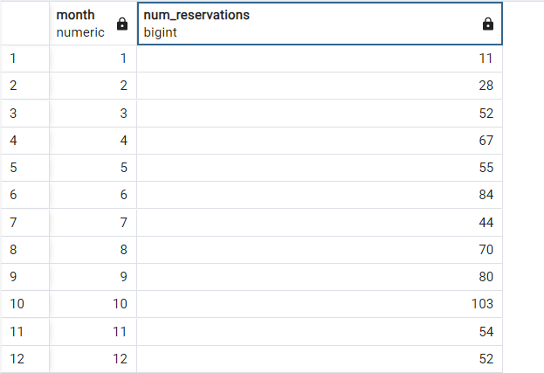

Slide 18
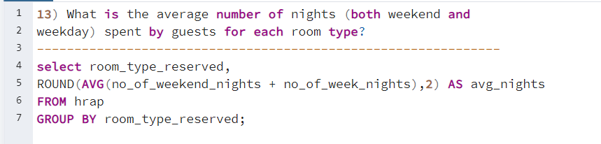
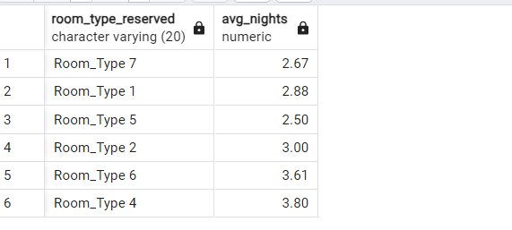

Slide 19
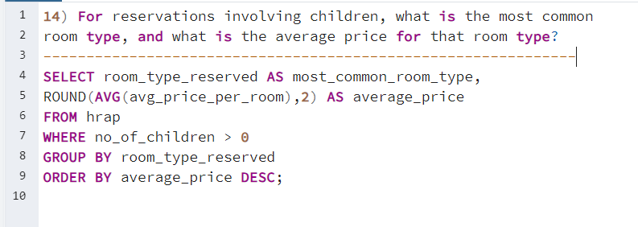
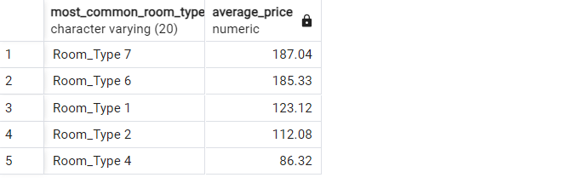

Slide 20
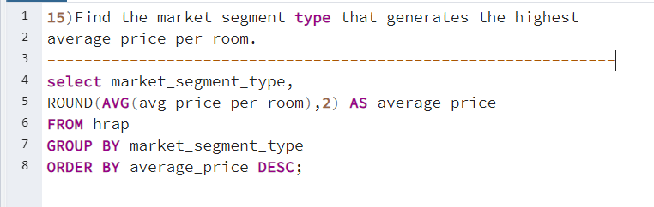
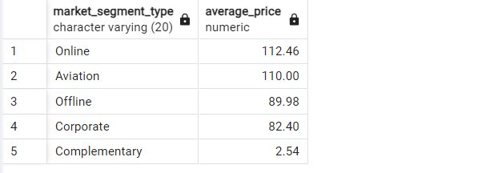

Slide 21
Summery
SQL is a useful language for handling databases and pulling out important queries to analyze data quickly and efficiently.

Slide 22
Thank you!

